Slide 1
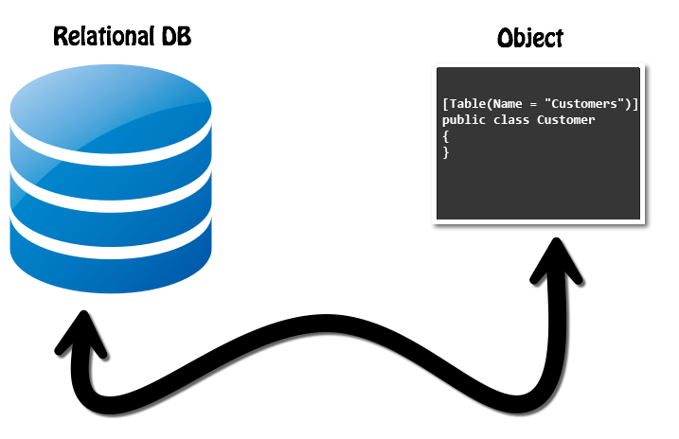
ORM Fundamentals
The ORM Concept, Config, CRUD Operations
SoftUni Team
Technical Trainers
Software University
https://about.softuni.bg/

Slide 2
Table of Contents
Introduction to ORM
Architecture
Example
Approaches
ORM Advantages
2

Slide 3
Questions
sli.do #java-db

Slide 4
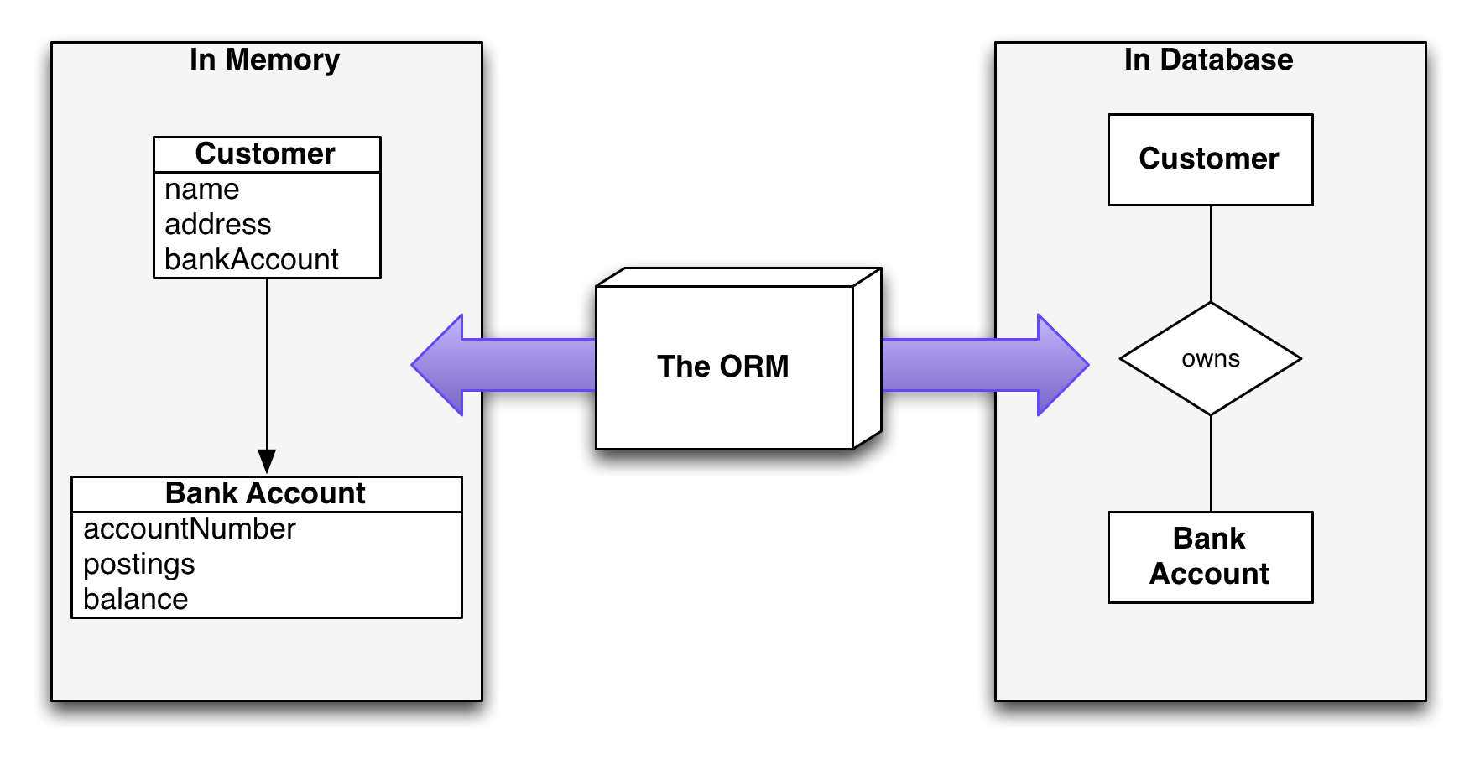
ORM Introduction
Object-Relational Mapping

Slide 5
What is ORM?
Technique for converting data between incompatible type systems using object-oriented programming languages
Object-Relational Mapping (ORM) allows manipulating databases using common classes and objects
Java/C#/etc. classes ➔ Database Tables
Database Tables ➔ Java/C#/etc. classes
5

Slide 6
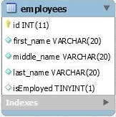
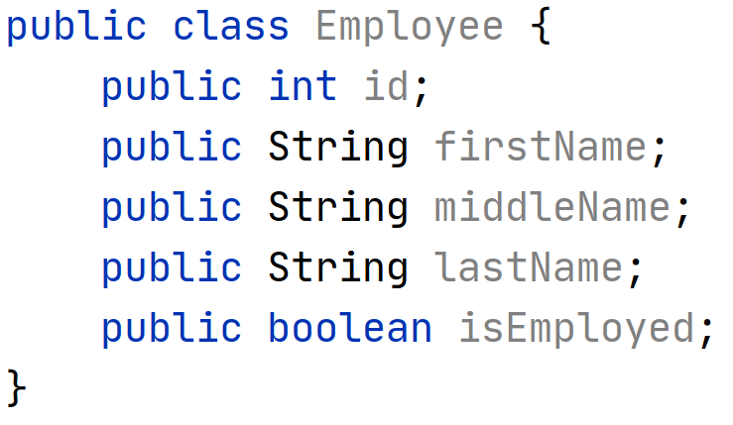
What is ORM? (2)
6

Slide 7
Why do we need ORM?
In OOP, data-management tasks act on objects that are almost always non-scalar values
Many database can only store and manipulate scalar values, organized within tables
We must manually convert values into groups of simpler values to store in DB and convert them back when we retrieve data
7

Slide 8
JDBC and ORM
The main difference, between JDBC and ORM, is complexity
JDBC/SQL
If the application is simple as to present data directly from the database
ORM
If the application is domain driven and the relations among objects is complex

Slide 9
Application Architecture
Presentation Layer
Service Layer
Database
Persistence Layer
ORM
9

Slide 10
ORM Frameworks: Features
ORM frameworks typically provide the following functionality:
Automatically generate SQL to perform data operations as:
persist, update, delete, merge, createQuery and so on.
Object model from database schema (DB First model)
Database schema from object model (Code First model)

Slide 11
Perform data operations with ORM (1)
Automatically generate SQL to perform data operations
Save entity to DB
Retrieve data from DB
INSERT INTO students
(firstName, lastName)
VALUES
('George', 'Brown')
Student student = new Student('George', 'Brown'); session.save(student);
Student student = (Student) session.get(Student.class, 1);
SELECT * FROM students WHERE id=1;

Slide 12
Perform data operations with ORM(2)
We can use and specific ORM Query Language as HQL or SQL
Using HQL
Using SQL
List<Student> studentList = session.createQuery("FROM Student").toList();
String sql = "SELECT * FROM Employee";
SQLQuery query = session.createSQLQuery(sql);
query.addEntity(Employee.class);
List<Employee> results = query.list();

Slide 13
Code First Model
Models the database after the entity classes
Database
Java
Student
Student
Code First
Employee
Employee

Slide 14
POJO + XML
A bit old-fashioned, but very powerful
Implemented in the "classical" ORM
...
<description>Mapping file</description>
<entity class="Employee">
<table name="EMPLOYEETABLE"/>
<attributes>
<id name="id">
<generated-value strategy="TABLE"/>
</id>
<basic name="name">
<column name="EMP_NAME" length="100"/>
</basic>
<basic name="salary">
</basic>
</attributes>
</entity>
...

Slide 15
POJO Mapped to DB Tables
Based on Java annotations and XML
Easier to implement and maintain
@Entity
@Table(name = "employees")
public class Employee {
@Id
private int id;
@Column(name = "name")
private String name;
@Column(name = "position")
private String position;
}

Slide 16

ORM Advantages
And disadvantages

Slide 17
ORM Advantages (1)
Productivity
Eliminates repetitive code
Generates database automatically
Maintainability
Fewer lines of code
Easier to manage object model changes

Slide 18
ORM Advantages (2)
Performance
Lazy loading
Caching
Database vendor independence
The database is abstracted
Can be configured outside the application

Slide 19
ORM Disadvantages
Reduced performance
Due to overhead or auto generated SQL
Reduces flexibility
Some operations are hard to implement
Lose understanding
What the code is actually doing - the developer is more in control using SQL

Slide 20

Summary
Object-Relational Mapping (ORM) allows manipulating databases using common classes and objects
The main difference, between JDBC and ORM, is complexity
POJO + XML mapping
POJO mapped to DB tables
…
…
…

Slide 21
Questions?
Notes:
21

Slide 22













SoftUni Diamond Partners

Slide 23


Educational Partners

Slide 24
Trainings @ Software University (SoftUni)
Software University – High-Quality Education, Profession and Job for Software Developers
softuni.bg, about.softuni.bg
Software University Foundation
softuni.foundation
Software University @ Facebook
facebook.com/SoftwareUniversity
Software University Forums
forum.softuni.bg
24
Notes:
24

Slide 25

License
This course (slides, examples, demos, exercises, homework, documents, videos and other assets) is copyrighted content
Unauthorized copy, reproduction or use is illegal
© SoftUni – https://about.softuni.bg
© Software University – https://softuni.bg
Notes:
25

